Slide 1
FYP Final-Presentation
Assessment: Carebuddy App
Name: Mock Ying Jing (224416M)
Supervisor: Ms Low Jia Xin

Slide 2
TABLE OF CONTENTS
01.
02.
03.
04.
05.
07.
09.
Introduction
Project Development Flow
System Overview
System Design
06.
08.
Features Implementation
Product Demo
Improvements based
on user’s requirements
Project Challenges
and Solutions
Conclusion

Slide 3
01. Problem Statement
Nearly 25% of the population in Singapore is expected to be 65 years or older by 2030, as the country’s demographic are shifting towards an aging population.
This rapid increase in the demographic creates significant challenges for caregivers:
Increased demand for caregiving services.
Ensuring elderly safety and well-being.

Slide 4

01. Project Objectives
To develop a user-friendly cross-platform mobile application, which:
Enable continuous real-time monitoring of elderly’s activities.
Provide caregivers with timely alerts of the elderly.
Enhance the overall care management of the elderly.
Notes:
For e.g. when there is no activity by the elderly user for one day at 11 AM and 5PM.

Slide 5
01. Project Deliverables
Real-Time Monitoring Activities (Proposed Features)
Journal Entry:
1) Live journal access and capture.
Blood Pressure Tracker:
2) Blood pressure input form for elderly.
3) Real-time data access for caregivers.
4) Elderly blood pressure data analytics.
Activity Planner:
5) Managing daily activities and tracking activity status.
Notes:
Real-time monitoring where the journal entry includes capturing and view real-time journal entries. Blood pressure tracker which include blood pressure input form, real-time data access, and data analytics. Activity planner which include plan, delete and view activities, as well as submit completion status for tracking activities.

Slide 6
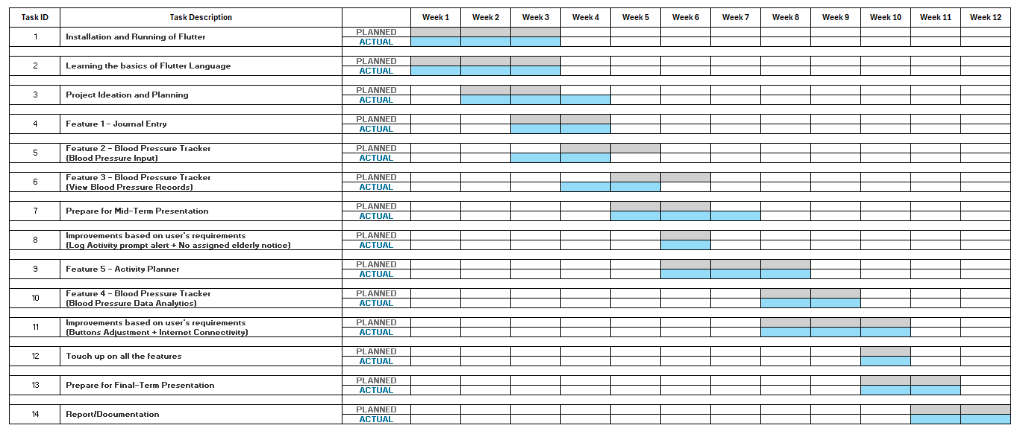
02. Gantt Chart

Slide 7


03. System Overview
Open-source framework by Google.
Builds beautiful, natively compiled multi-platform applications from a single codebase.
Support Android & iOS devices with a consistent look and feel.
Fast, productive, and flexible.
Comprehensive platform by Google.
Offers extensive backend services, including cloud computing.
Provides real-time NoSQL cloud databases to store and sync data between users.

Slide 8


03. System Overview
Open-source code editor by Microsoft.
Integrated Development Environment (IDE).
Test Flutter applications using Android and iOS Emulator.
A free online cloud-based Jupyter notebook environment.
Allows developers to train machine and deep learning models.

Slide 9
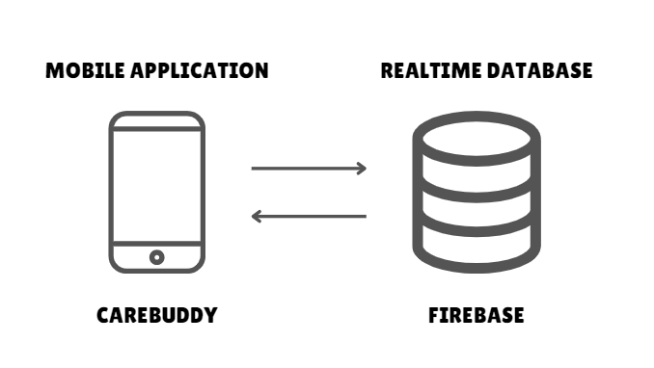
04. System Design

Slide 10
05. Feature Implementation
Why I choose Journal Entry Feature?
1. Acts as a Personal Diary:
Provides a safe space for elderly to record their thoughts and experiences.
Helps maintain mental well-being.
2. Capture Real-Time Records:
Enables a digital format that is easy to access and review.
Facilitates the keeping of memories and daily events.
Notes:
I choose this feature because firstly, it acts as a personal diary as it provides a safe space for elderly to record their thoughts and experiences, maintaining their mental well-being.
Secondly is capture real-time records. It enables a digital format that is easy to access and review, facilitating the keeping of memories and daily events.
This is especially beneficial because elderly as they may tend to forget details or have difficulty keeping track of information over time.

Slide 11
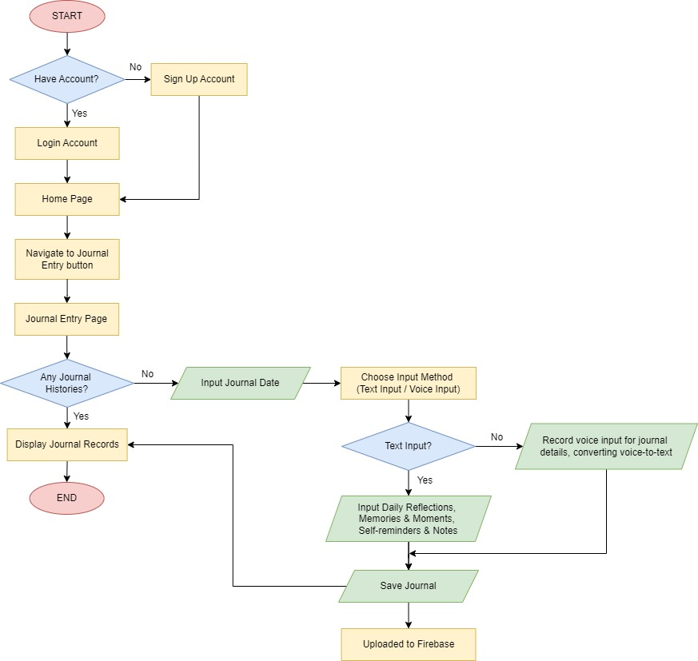
Journal Entry Flow Chart
Notes:
How it works

Slide 12
05. Feature Implementation
Why I choose BP Input Feature?
Convenience:
Simplifies the process of recording and sharing blood pressure readings (E.g. Using digital records).
2. Enhanced Communication:
Improves communication between elderly and caregivers with real-time health information.

Slide 13
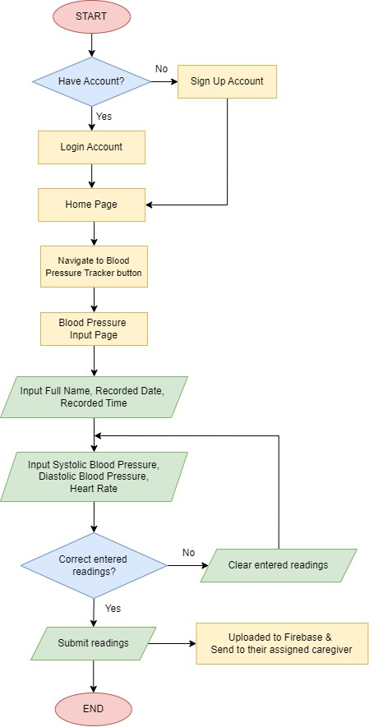
BP Input Flow Chart
Notes:
How it works

Slide 14
05. Feature Implementation
Why I choose View BP Records Feature?
1. Real-Time Monitoring:
Enables remote monitoring of elderly’s daily blood pressure records regularly for timely interventions.
2. Timely Interventions:
Quickly identify elderly’s blood pressure status to take appropriate actions.
3. Enhanced Communication:
Easier communication between caregivers and healthcare professionals based on real-time data.
Notes:
This is beneficial for caregivers and healthcare professionals as they can discuss on the appropriate actions to be made when there is abnormalities in blood pressure readings.

Slide 15
05. Feature Implementation
Why I choose BP Data Analytics Feature?
1. Holistic Health Overview:
Provides caregivers with a complete view of elderly’s blood pressure history.
2. Proactive Health Management:
Supports early detection of potential health issues by identifying abnormalities for immediate actions.
3. Visual Data Representation:
- Simplifies monitoring and understanding of blood pressure trends for caregivers.

Slide 16
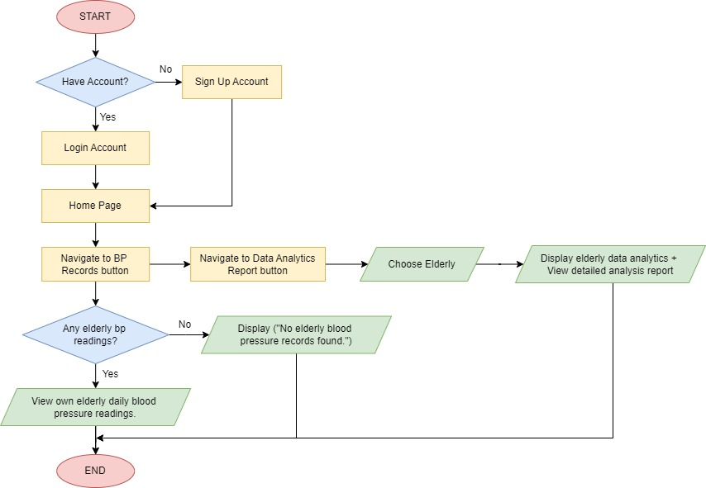
BP Tracker & Analytics Flow Chart
Notes:
How it works

Slide 17
05. Feature Implementation
Why I choose Activity Planner Feature?
1. Centralized Management:
Caregivers can manage activities from one unified system.
2. Real-Time Tracking:
Caregivers can monitor elderly’s activity completion status in real-time.
3. Increased Elderly Engagement:
Elderly can view and participate in their planned activities, promoting a higher level of involvement and motivation.
Notes:
Centralized Management: Allows caregivers to plan, view, and delete activities from one unified system.
Real-Time Tracking: Provide caregivers with the ability to monitor elderly’s activity completion status in real-time, helping assess the effectiveness and make informed decisions.
Enhanced Communication: Facilitates direct interaction between caregivers and elderly through activity scheduling and completion tracking. This ensures that activities are planned and tracked systematically, leading to better coordination between caregivers and elderly users.

Slide 18
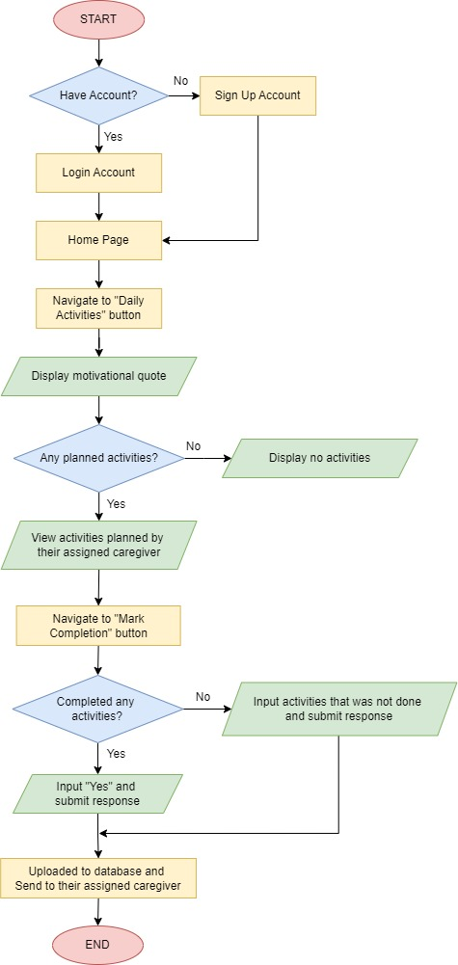
Activity Planner Flow Chart
For the elderly:
Notes:
How it works

Slide 19
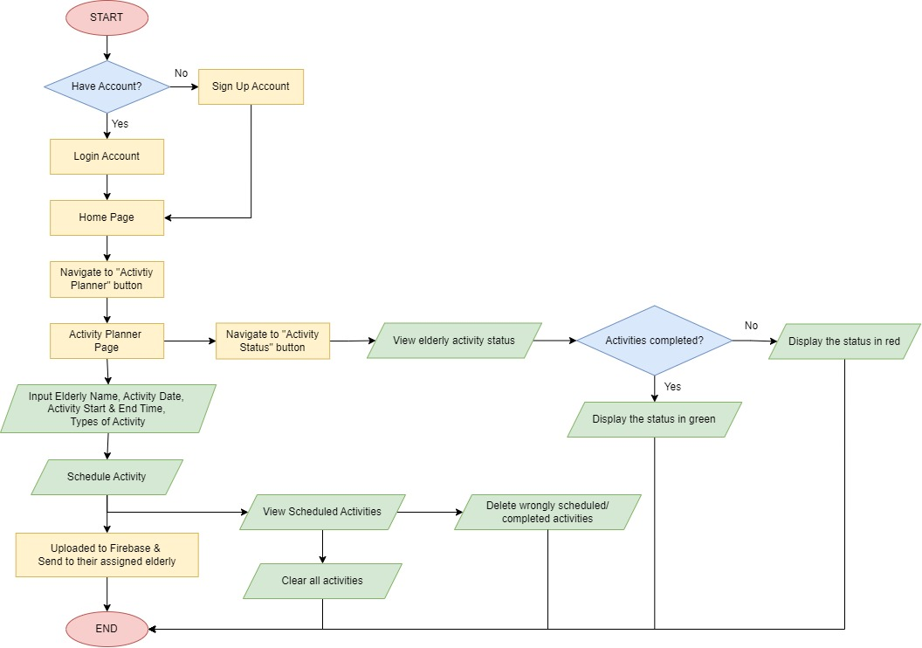
Activity Planner Flow Chart
For the caregiver:
Notes:
How it works

Slide 20
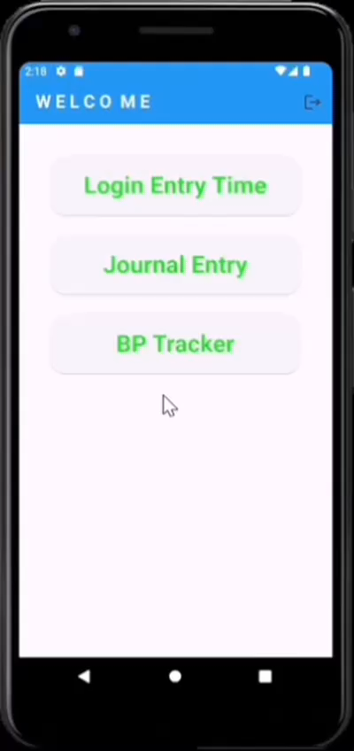
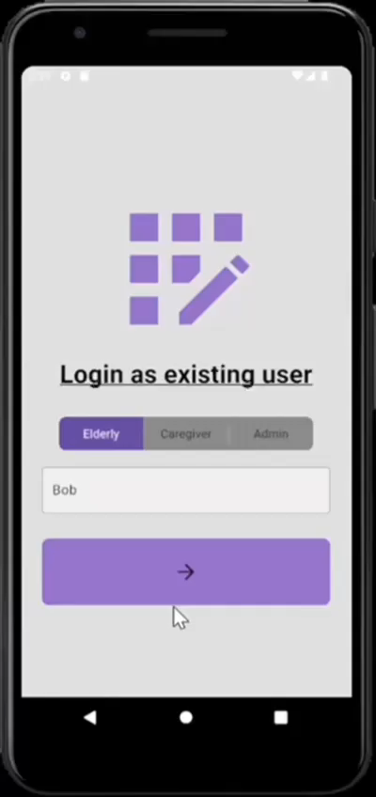
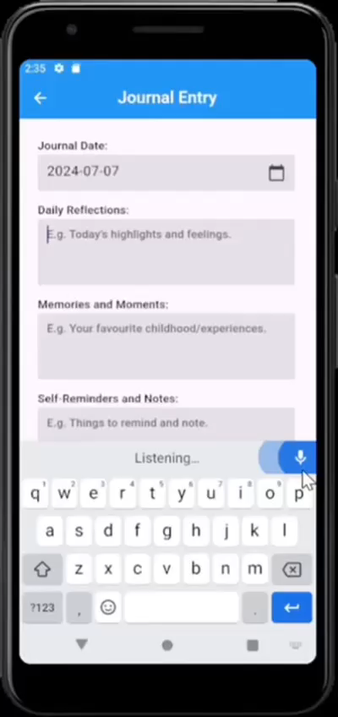
06. Journal Entry Demo
Write and Save
Journal
Access Permission
Voice-to-Text
Notes:
Elderly is able to write and save their own journal.
When Bob login, he will not be able to see other elderly’s journal.
Include the snackbar like “It will show journal saved”
As some elderly might have difficulty typing, it offers a voice-to-text option where the elderly can speak and it will convert their voice to text.

Slide 21
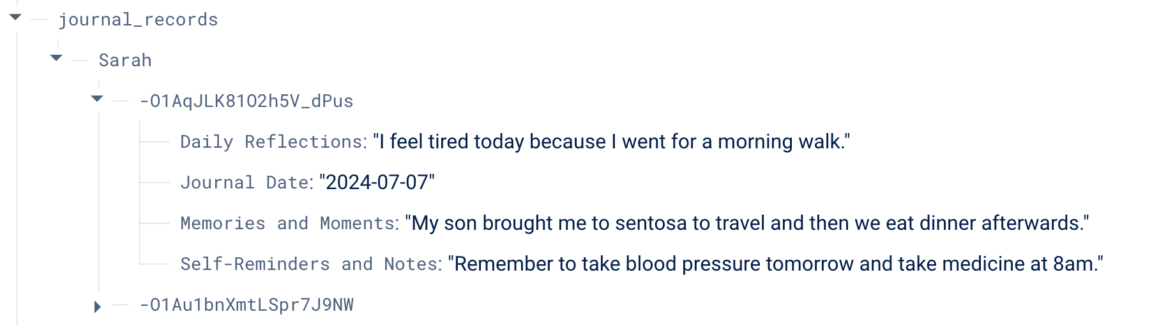
06. Journal Entry Demo
Entries uploaded to firebase

Slide 22
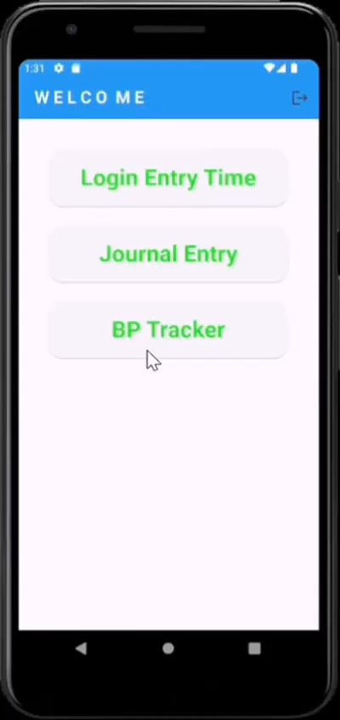
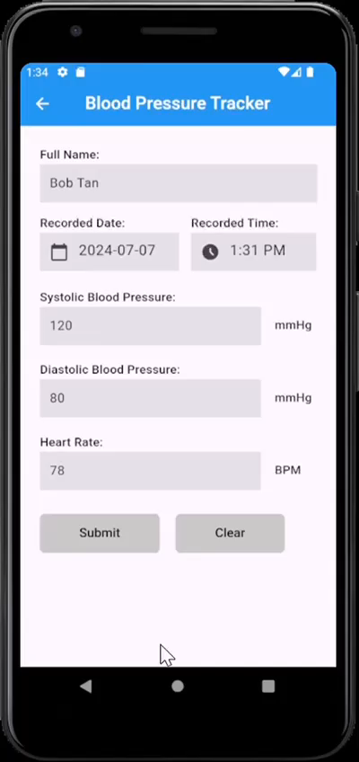
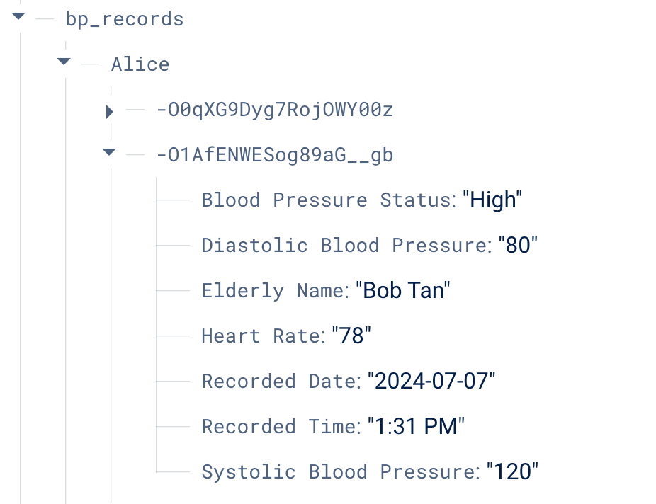
06. BP Input Demo
Clear entered readings
Input & Submit
BP Readings
Readings uploaded to firebase
Notes:
Include the snackbar like “It will show records been submitted”

Slide 23
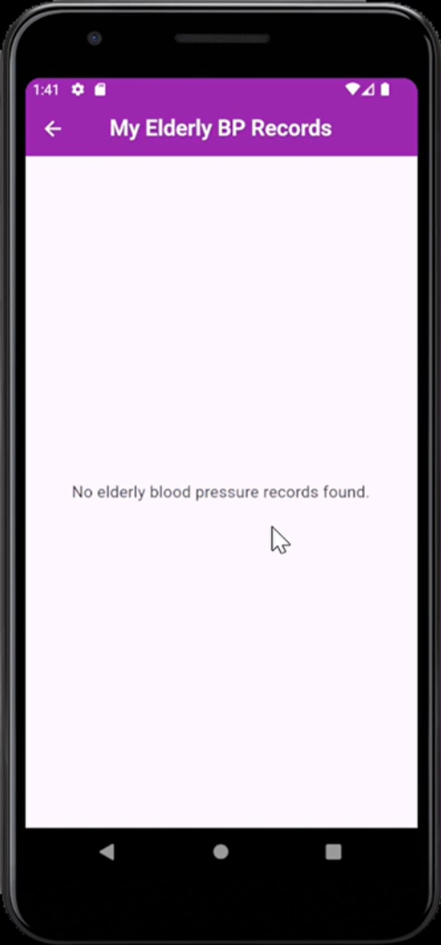
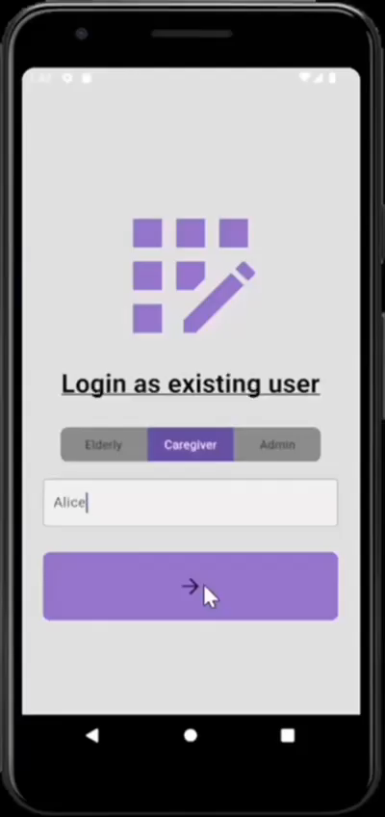
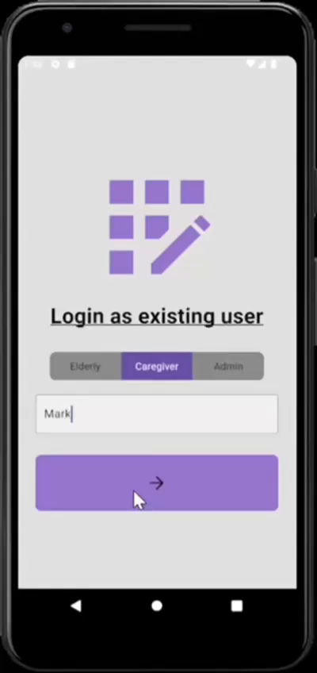
06. View BP Records Demo
No records found
(Elderly yet to submit)
View elderly blood pressure records (Access Permission)
Notes:
No records found because elderly yet to submit their readings
After elderly had submitted their bp readings, their assigned caregivers is able to view their elderly bp records.
When login as XX, able to see XX records.

Slide 24
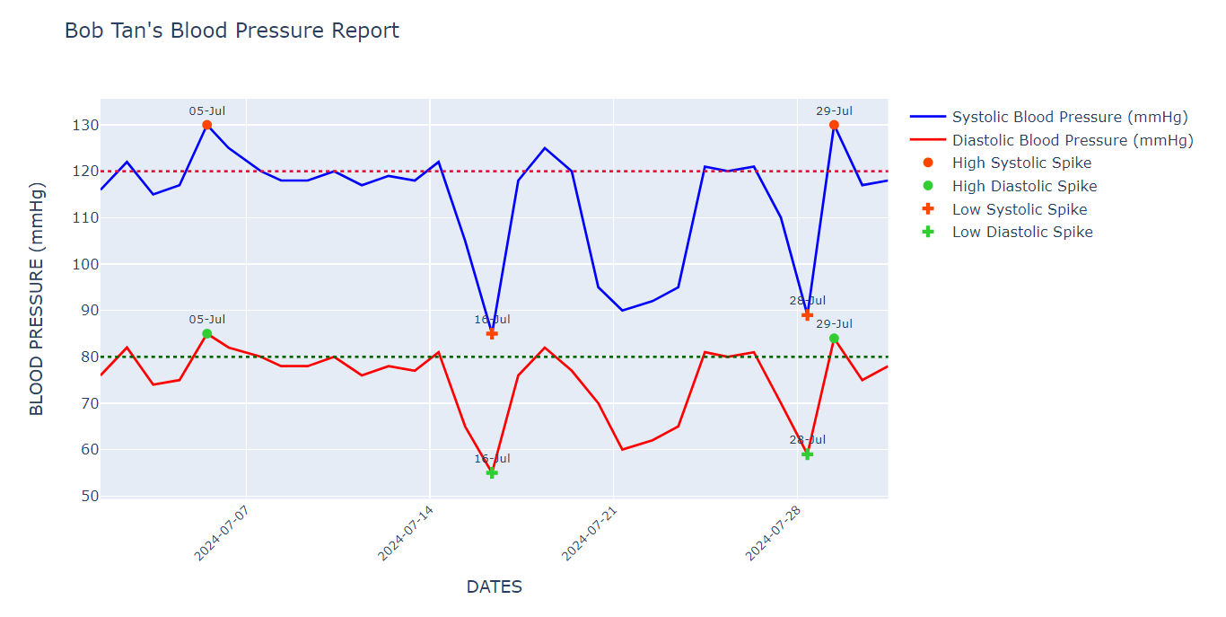
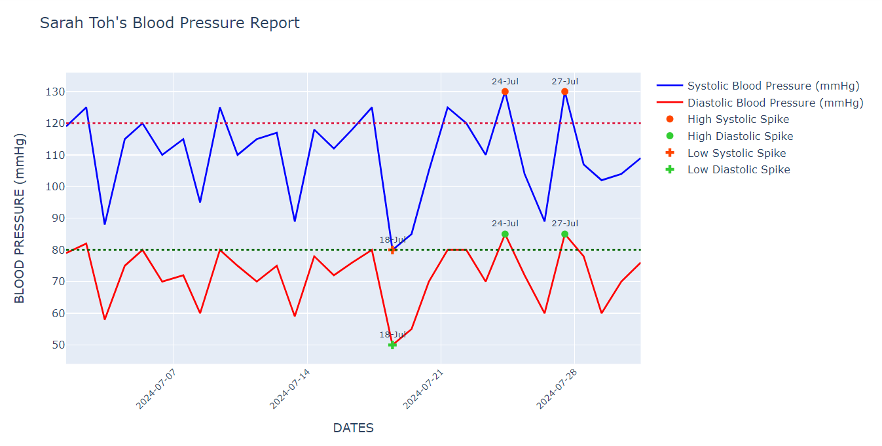
06. BP Data Analytics Demo
1-month data of July
* Offline graph, but possible to be hosted on web services
in the future (E.g. Clicking URL for real-time graph)
Notes:
This is the blood pressure analytics graph for one-month data of July. I I screenshot and put into the mobile app. Due to time constraints, I am currently doing offline but is possible to be hosted on web service in the future so the caregiver can just click on the url to view the real-time graph.

Slide 25
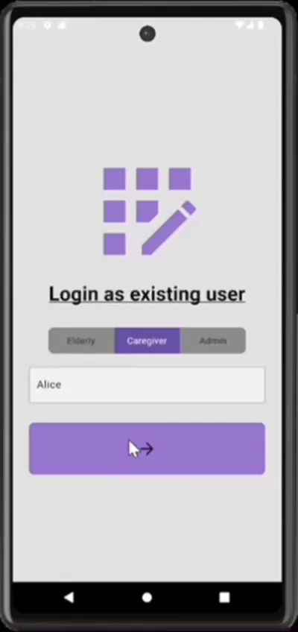
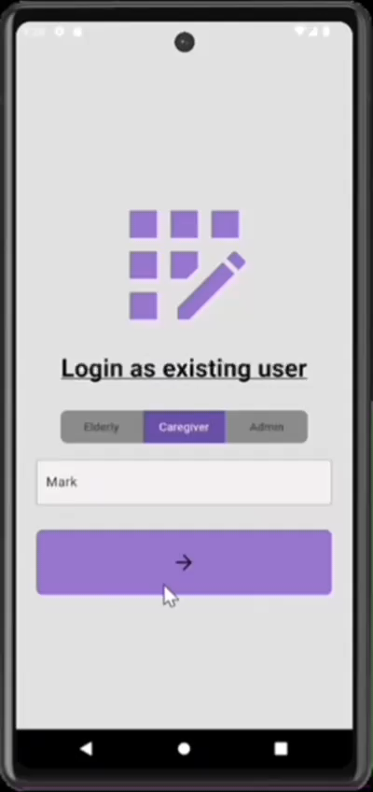
06. BP Data Analytics Demo
View elderly blood pressure data analytics (Access Permission)
Notes:
The caregiver are able to view their own elderly blood pressure data analytics.
This is when login as XX, choose elderly, able to see XX data analytics where the graph will provide some observations some actions that they can take for high and low blood pressure.

Slide 26
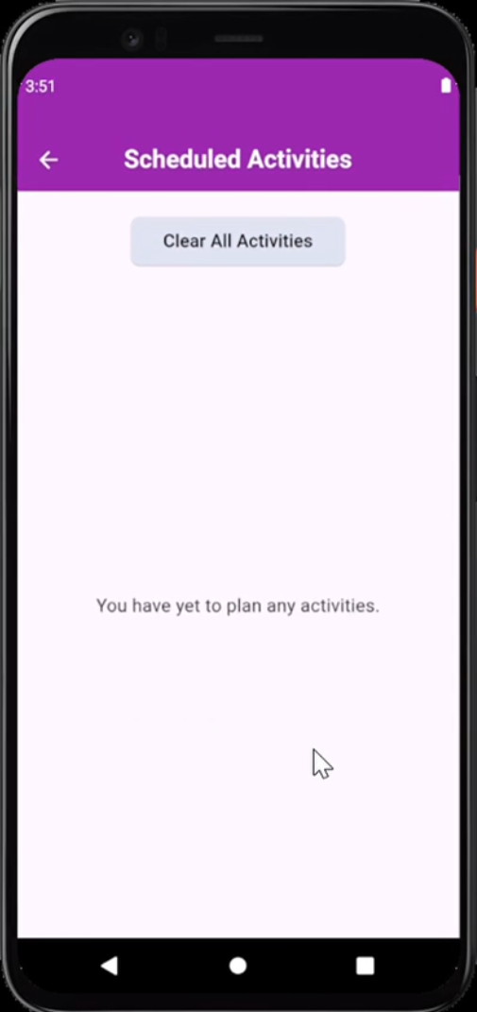
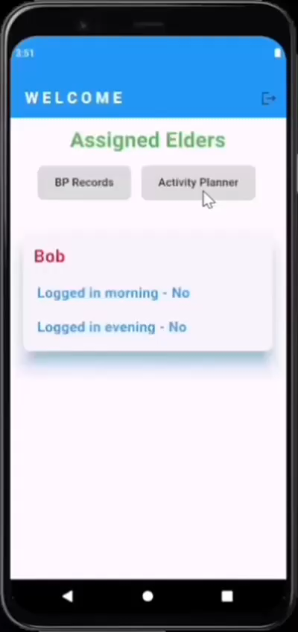
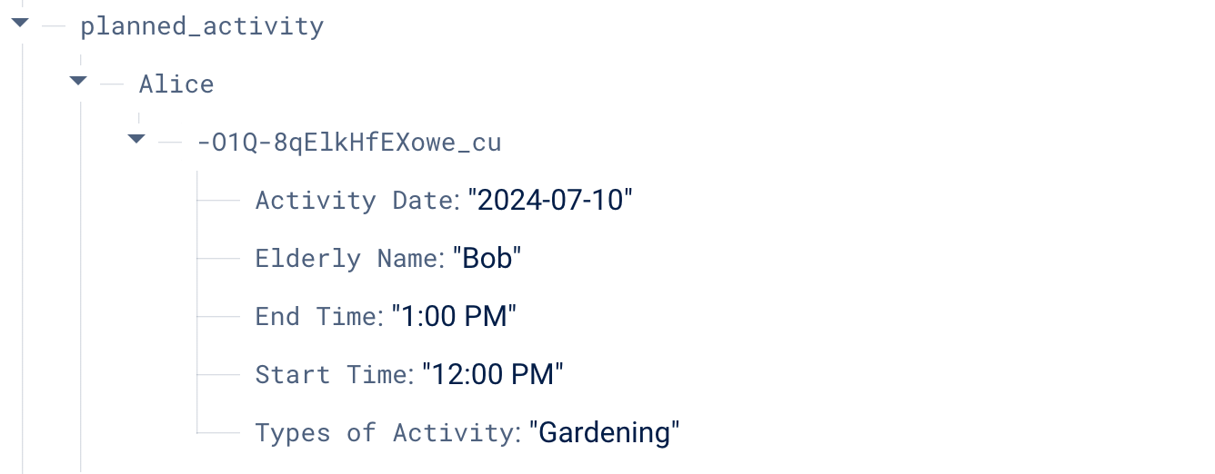
06. Activity Planner Demo
Caregiver Plan &
View Activities
No activities found
(Activities yet to plan)
Activity uploaded to firebase
Notes:
Include the snackbar like “It will show records been submitted”

Slide 27
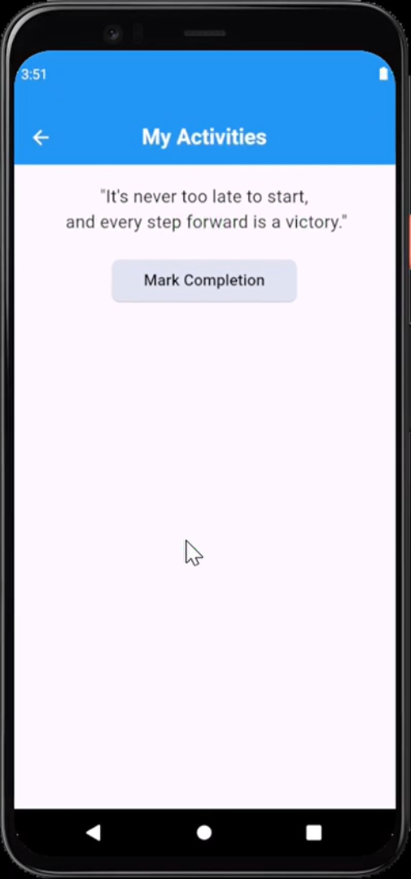
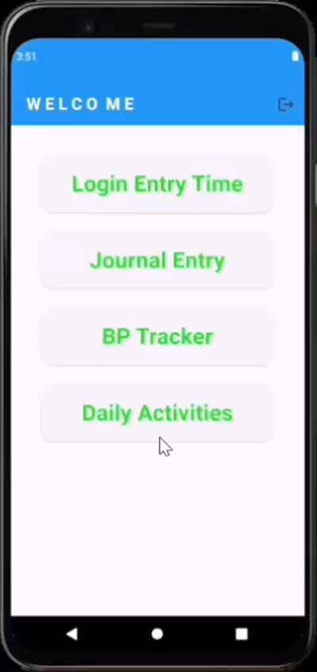
06. Activity Planner Demo
Elderly view
planned activities
No activities found
(Caregivers no plan activities)
Notes:
No records found because caregiver yet to plan activity for the elderly
After caregiver planned activity, their assigned elderly will be able to view their planned activities
For example, when login as Bob, he will be able to see his planned activities for the day.

Slide 28
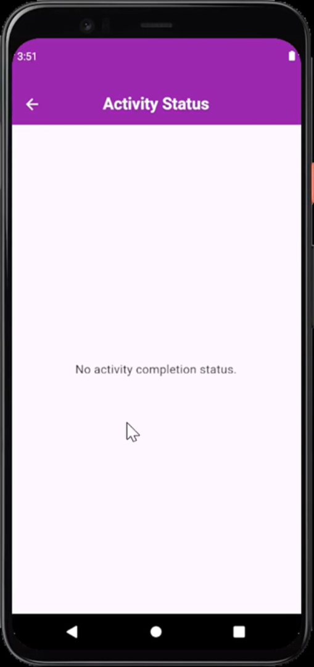
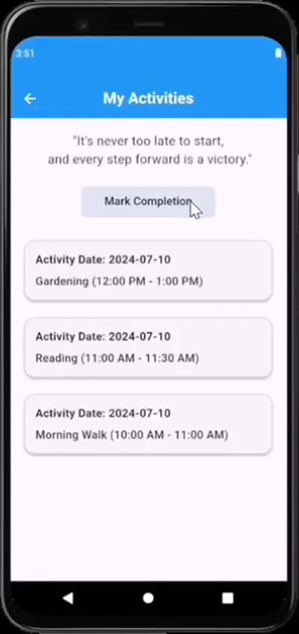
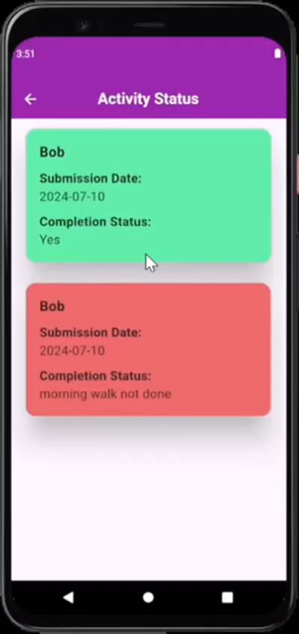
06. Activity Planner Demo
No activity status found
(Elderly yet to submit)
Elderly submit activity
completion status
Caregiver Track Elderly
Activity Status
YES & NO
Notes:
Activity status
When caregiver login, does not see activity status because elderly yet to submit.
When elderly submit their activity completion status, for example yes and another example as no, it will be sent to the caregiver and firebase.
Caregiver example Alice can track the elderly activity status
Activities will be indicated with different colors.

Slide 29
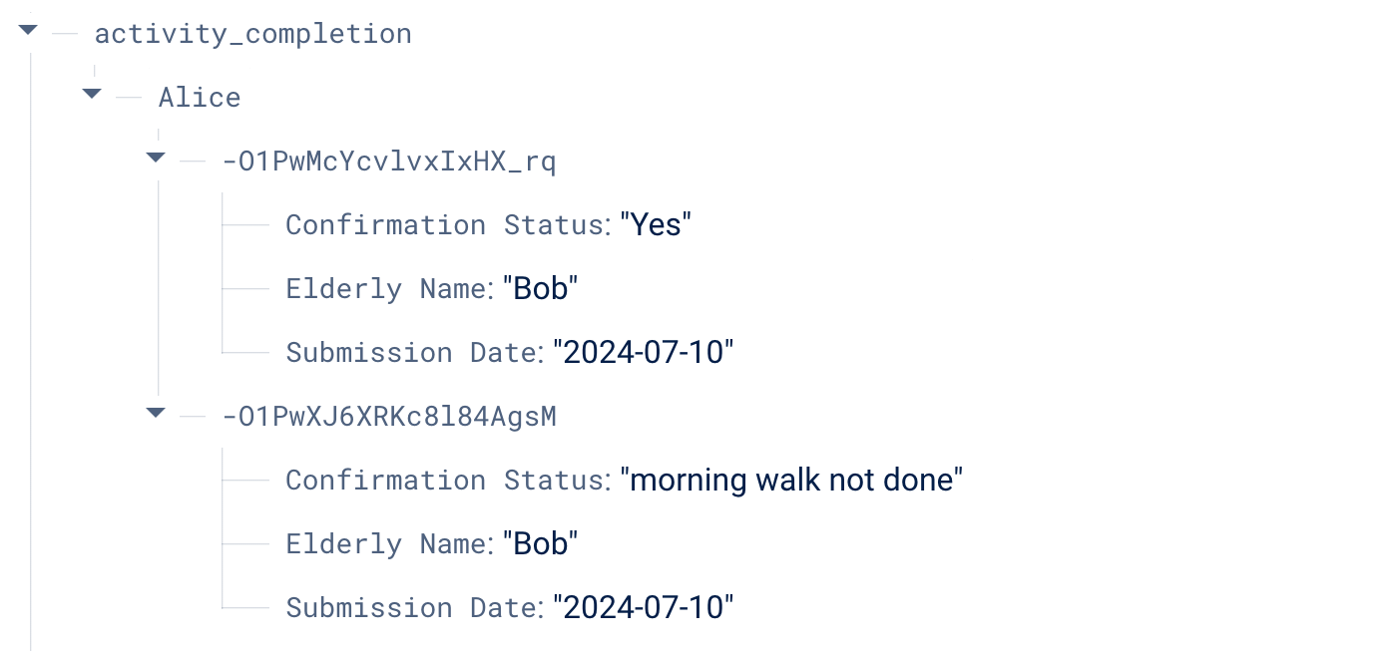
06. Activity Planner Demo
Activity Status uploaded to firebase
Notes:
Need change

Slide 30
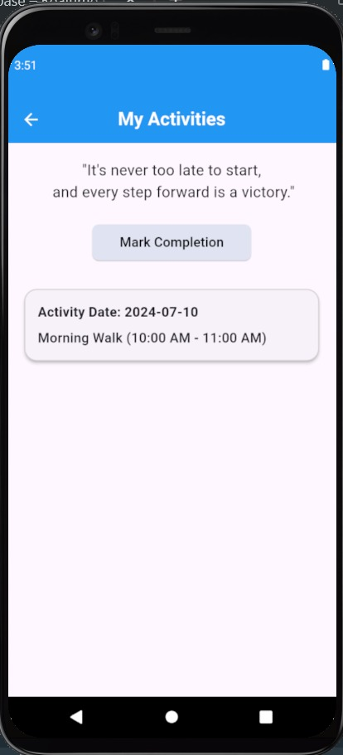
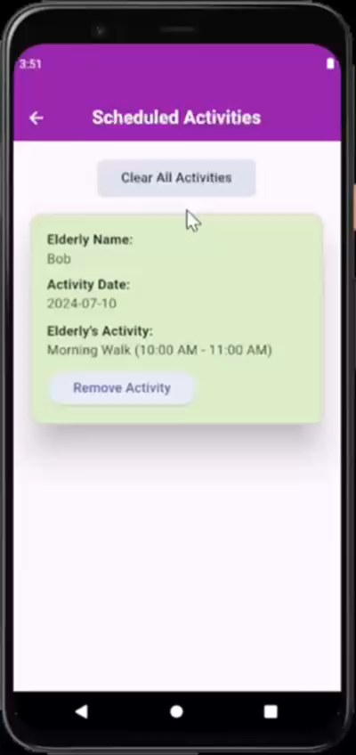
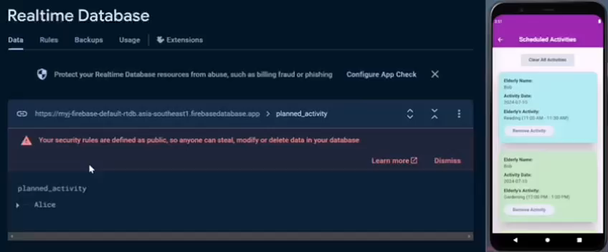
06. Activity Planner Demo
Elderly view
updated activity
Clear All Activities
Remove certain activity +
Activity deleted from firebase
Notes:
As some caregiver might schedule activity wrongly or elderly had completed the activity based on the activity status, they have the option to remove certain activity from the app. At the same time, the activity that was removed from the app will be deleted from firebase. After removing the activities, their elderly will be able to view the updated activities they have to do. The caregiver also have the option to clear all activities if they want to reset the whole activities in the app or there are too much activities shown.

Slide 31
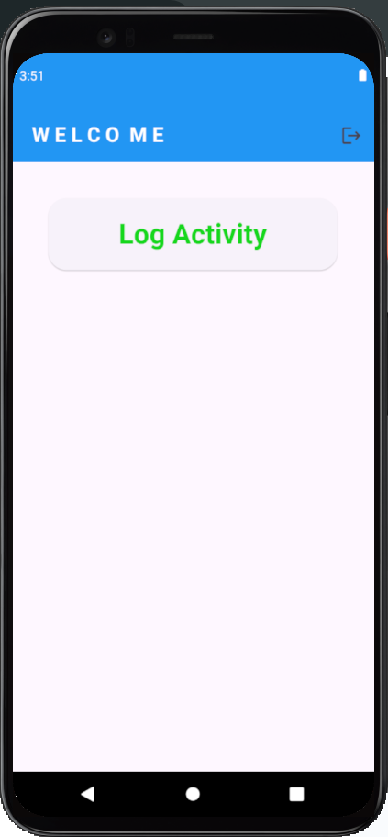
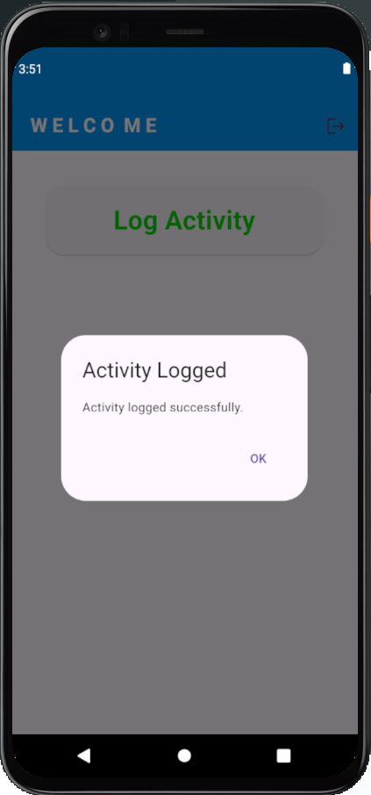
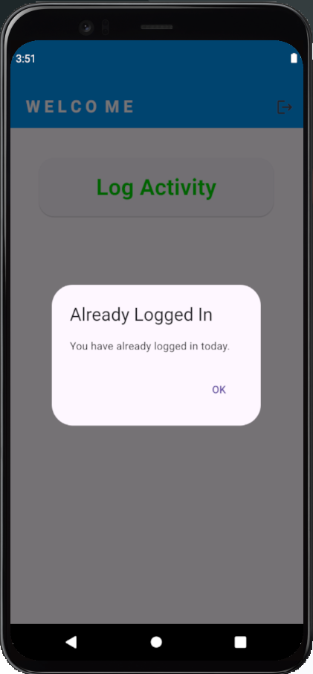
07. Improvements based on User’s Requirements
Notes:
I changed the button to log activity. When the elderly click on the button, it wil show that they had logged successfully. When they clicked again, it will show that they had already logged in.

Slide 32
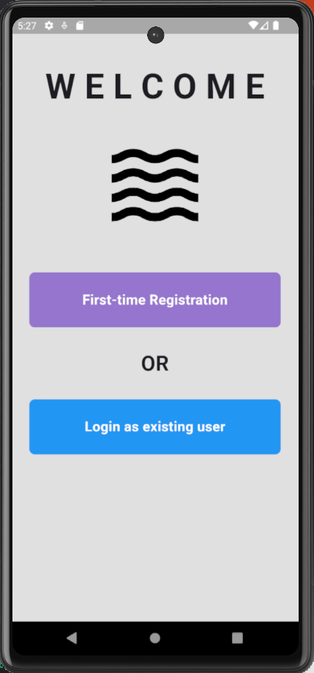
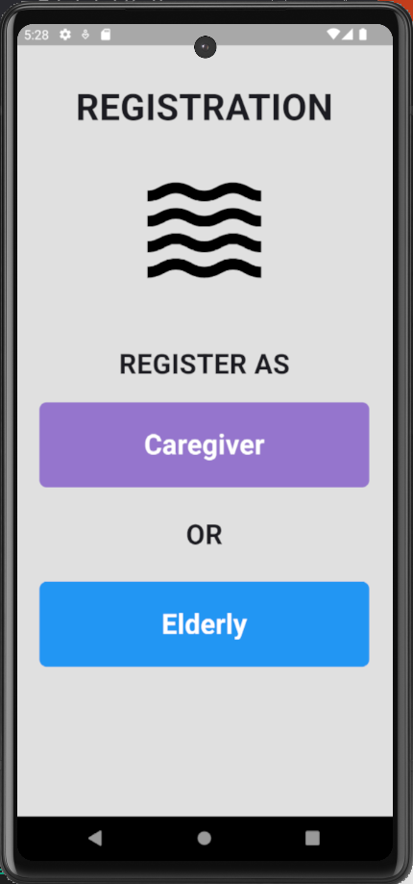
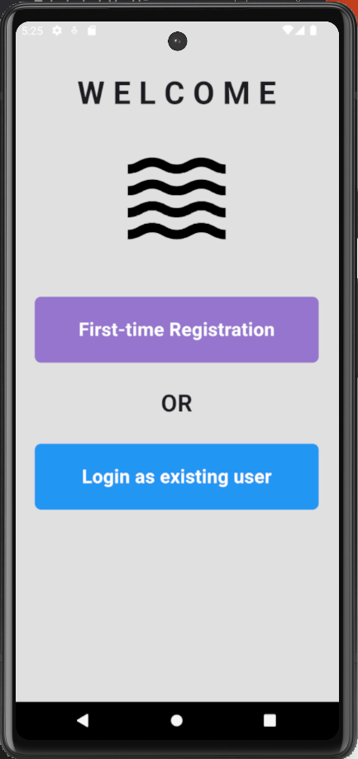
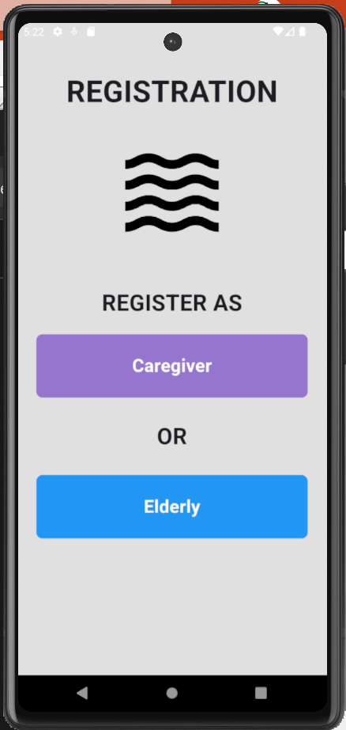
07. Improvements based on User’s Requirements
Before Adjustments
After Adjustments
Notes:
This is the before and after adjustments of the button

Slide 33
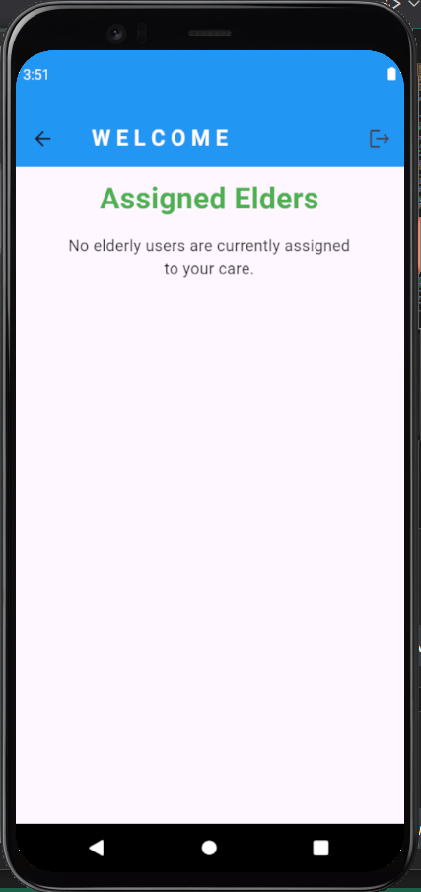
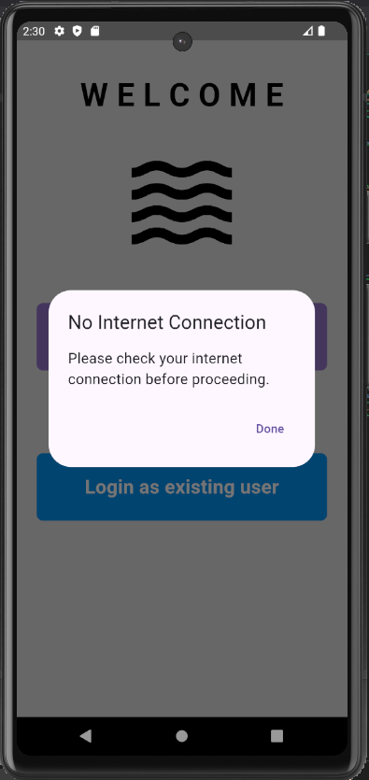
07. Improvements based on User’s Requirements
No assigned elderly notice
Internet Connectivity
Notes:
I also implemented a prompt alert function for internet connectivity where the elderly and caregiver cannot proceed if they are not connected to the internet.

Slide 34
08. Project Challenges and Solutions
Understanding a new programming language:
Read documentations and watch online tutorials such as Dart language for better understanding.
2. Laptop and Software Crashes:
Borrowed a laptop for my project, allowing me to continue without any disruptions.
Coding of Features:
Research online for resources such as Firebase documentation on how to fetch and delete data from Firebase.

Slide 35
09. Conclusion
Journey of learning and problem-solving in coding a mobile application.
Gained valuable insights into using different programming language.
Applied critical thinking to understand and meet user needs.
Developed diverse features inspired by real-life experiences.
Notes:
Throughout these 12 weeks,
This project has been a journey of learning and problem-solving, where I gained valuable insights into various aspects of coding a mobile application using different programming language. I had utilized my critical thinking skills to understand and meet user needs and expectations, developing diverse features inspired by real-life experiences.

Slide 36
Thank You
Do you have any questions?

